Slide 1
Introduction to Containers
Thomas Juettemann, EMBL-EBI
Notes:
Hello Everyone and welcome. In this segment of the course I will introduce you to container technologies. First we will have a look for what caused the need for this technology. Then we explore what a container actually is, how it compares to a virtual machine and which are the main container technologies.
In exercises you will learn how to deploy a container and how to create the image which acts as the blueprint.

Slide 2

Background How did we get here?

Slide 3

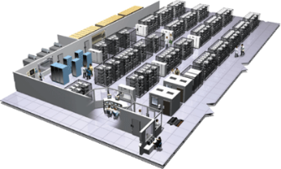
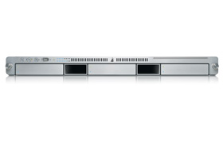
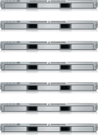
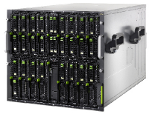

The Challenge
Static website
User DB
Queue
nginx 1.5 + modsecurity + openssl + bootstrap 2
postgresql + pgv8 + v8
HDF5 + kita
Redis +
redis-sentinel
Analytics DB
Do services and apps interact appropriately?
Multitude
of
Stacks
hadoop + hive + thrift
+ OpenJDK
Background workers
Web frontend
API endpoint
Python 3.9 + genrich + ataqv
+ phantomjs
Ruby + Rails + sass +
Unicorn + hdfview
Python 2.7 + Flask + pyredis +
celery + psycopg + postgresql-client
Development VM
Production
Cluster
Public Cloud
Multiplicity of hardware environments
Can I migrate smoothly and quickly?
QA server
Disaster recovery
Data Center(s)
Contributor’s laptop
Production Servers
Notes:
Modern day development (focusing on the web here) lives in a world of lots of complexity. In even the most basic application you are likely to have a back-end language that lives on the server, a front-end language that lives on the client, third-party and in-house libraries for both languages to manage, a database, an operating system (often deploying to Linux but developing on a different OS). And this is for a basic app! What if you have utility programs that are written in another language? What if you have other uncommon dependencies and requirements?
The point is that this all adds up to a lot of complexity, and worst of all- it is complexity that you have to manage across multiple platforms. If I got an app up and running on my MacBook, and wanted to deploy to Linux, my options were not great. If you’ve ever administrated your own VPS, much less a bare metal server, you know what I mean. Having to install all of the packages and dependencies that you have in a totally different way is a recipe for headaches and tears. Getting stuff to production is a completely different ball game from writing it in the first place.
Bioinformatics tools add their own challenge. Trying to get tools to run with the limited power that one has on a computer farm is a challenge itself.

Slide 4
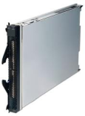
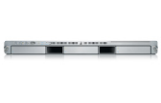
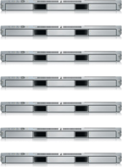


The Matrix From Hell
? | ? | ? | ? | ? | ? | ?
? | ? | ? | ? | ? | ? | ?
? | ? | ? | ? | ? | ? | ?
? | ? | ? | ? | ? | ? | ?
? | ? | ? | ? | ? | ? | ?
? | ? | ? | ? | ? | ? | ?
Static website
Web frontend
Background workers
User DB
Analytics DB
Queue
 | Development VM | QA Server | Single Prod Server | Onsite Cluster | Public Cloud | Contributor’s laptop | Customer Servers
Notes:
Different technologies on different platforms create a “Matrix from Hell” that makes even the most courageous person want to set her hair on fire.
Every software component, multiplied by every environment where it has to run one day.
Everything must work.
Code is developed on a laptop, and then shipped to production.
The production server does not run Ubuntu, but CentOS.
It uses a different version of libc and python.
In simple words, it is the challenge of packaging any application, irrespective of language/frameworks/dependencies, so that it can run on any cloud, irrespective of the underlying OS/hardware/infrastructure.

Slide 5
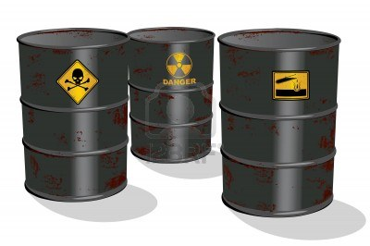

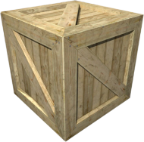
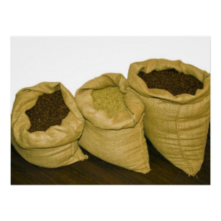
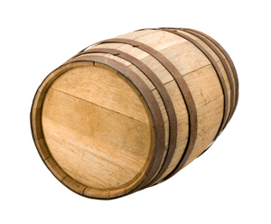
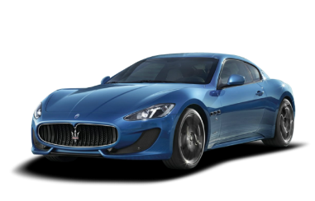
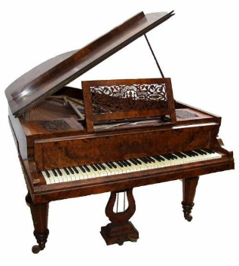




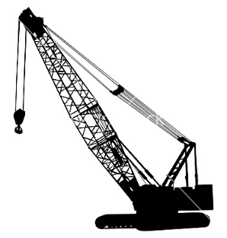
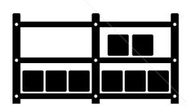

Cargo Transport Pre-1960
Do I worry about how goods interact (e.g. coffee beans next to spices)
Multiplicity of Goods
Multiplicity of methods for transporting/storing
Can I transport quickly and smoothly
(e.g., from boat to train to truck)
Notes:
Look around for a group of people who already had this problem. I need to ship coffee beans, I need to get them to the other side of the world. It is my problem how the goods are handled at every step of the way. Is the staff trained? What truck to use? The type of shipping depends on the type of my goods. Every provider needs an expert in-house who maps out routes and has the knowledge of the means of transports involved. A very fragile and expensive process.

Slide 6
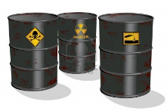

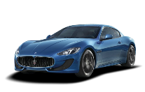


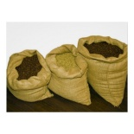


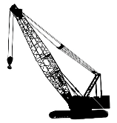



Also a matrix from hell
 | ? | ? | ? | ? | ? | ? | ?
 | ? | ? | ? | ? | ? | ? | ?
 | ? | ? | ? | ? | ? | ? | ?
 | ? | ? | ? | ? | ? | ? | ?
 | ? | ? | ? | ? | ? | ? | ?
 | ? | ? | ? | ? | ? | ? | ?
Notes:
You can present that with the same Matrix of Hell. Every item to ship multiplied by every possible way to ship goods.

Slide 7

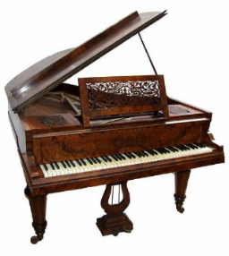

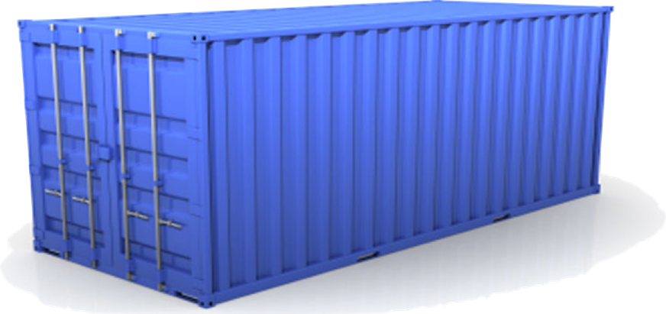
Solution: Intermodal Shipping Container
A standard container that is loaded with virtually any goods, and stays sealed until it reaches final delivery.
…in between, can be loaded and unloaded, stacked, transported efficiently over long distances, and transferred from one mode of transport to another
Notes:
The came up with a solution: a container. They agreed on the size, the weight, how the doors work, where the locks are, where the labels are put and so on. Infrastructure provider standardized on that, as well as people shipping goods.
With this, responsibilities shifted. If I want to ship coffee, I only need to put it into this box and seal it. From that point it is no longer my problem. I can hand it over to a wide variety of infrastructure providers, and even hand it over to a provider that I never dealt with. As an infrastructure provider I can focus on improving: faster boats, bigger truck, better organized facilities.

Slide 8
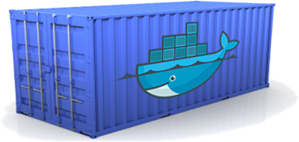
Docker is a shipping container system for code
Static website
User DB
Web frontend
Queue
Analytics DB
An engine that enables any payload to be encapsulated as a lightweight, portable, self-sufficient container…
…that can be manipulated using standard operations and run consistently on virtually any hardware platform
Development VM
QA server
Customer Data Center
Public Cloud
Production Cluster
Contributor’s laptop
Notes:
The same should be applied to software. It is embarrassing that moving software from one data center to another takes longer than shipping good from on side of the planet to the other.
Docker provides a standard way to pack software into a box, with standard properties, and then the box can be handed to other teams or infrastructure providers, and they know how to handle it.

Slide 9
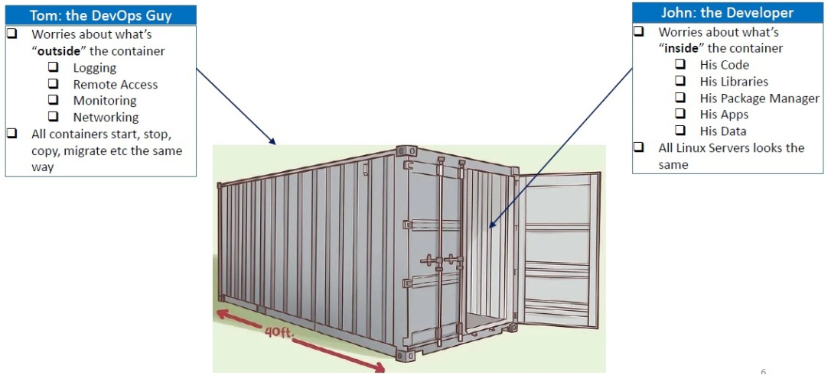
Separation of Concerns
https://crunchytechbytz.wordpress.com/2018/01/23/introduction-to-docker
Notes:
Developers can focus on bundling applications and dependencies as containers, without agonizing over underlying hardware/infrastructure. Administrators/DevOps team can concentrate on managing containers, without agonizing over the contents of those containers. All containers start, stop

Slide 10

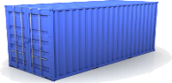
Docker eliminates the matrix from Hell
Static website
Web frontend
Background workers
User DB
Analytics DB
Queue
 | Development VM | QA Server | Single Prod Server | Onsite Cluster | Public Cloud | Contributor’s laptop | Customer Servers
Notes:
Uins

Slide 11
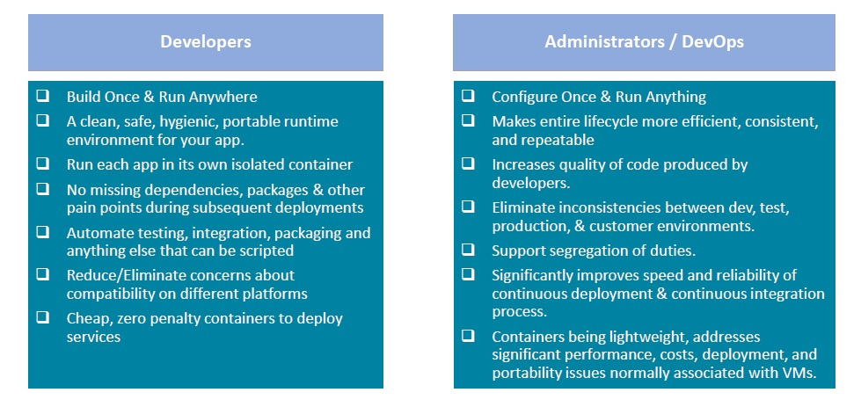
Benefits for Developers & Administrators
https://crunchytechbytz.wordpress.com/2018/01/23/introduction-to-docker
Notes:
Everyone benefits. For developers the long standing promise that Java gave finally came through, and as an added bonus, admins only need to configure once and then run everywhere. Apps are isolated, no more hassle with missing dependencies, no inconsistencies, improved speed and reliability etc. Great, isn’t it? This is usually the point where all the issues come up – but not here. It is as great as it sounds. Container do make your life much simpler.

Slide 12
Containerisation How does it work?

Slide 13


The needs of the one vs the needs of the many
VS
Single user
All resources
Multiple user
Limited resources
Data privacy
https://unsplash.com/photos/NuFUbftUu_s
https://images.app.goo.gl/aw1RRCeKKPCpf1yQ7
Notes:
On our laptop or desktop computer, we are the only one using resources. A computer farm usually hosts dozen or hundreds to thousands of users. Resources need to be shared fairly between all users, and great care must be taken to ensure users only have access their data or data that has been shared with them.

Slide 14

Resources
Processor
Hard drive
Memory
Network
How to separate resources?
Notes:
Clusters are a mix of processors, differing in their speed and the amount of RAM available. Hard drives can be mechanical or solid state. Some areas are backed up, some not. Network connections can have variable speed.
How are all these separations handled?

Slide 15

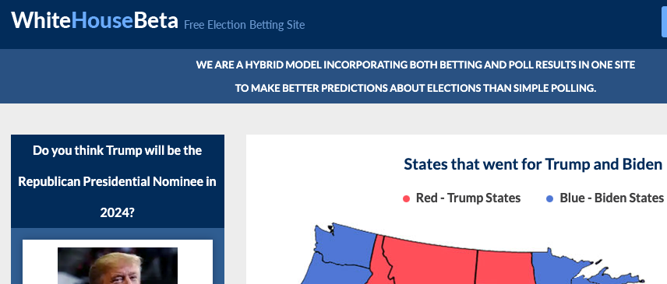

Namespaces!
www.whitehouse.gov
www.whitehouse.com
Python Namespace
Built-In
Global
Enclosing
Local
Files
C:\Program Files\Internet Explorer
/usr/local/apache
Notes:
A namespace is a group of related elements that each have a unique name or identifier. There are several different types of namespaces, and each one has a specific syntax used to define the corresponding elements. Each element within a namespace has a "local name" that serves as a unique identifier.
The world wide web is probably the most widely known namespace. It is read from right to left, common domain names include gov, com, eu, edu, uk etc. Let’s look at at the same element (whitehouse) in two namespaces (gov and com). The content is very different.
Another example is the “leave.eu” website. As the business behind it is in the UK, the registry manager decided after Brexit that it is in the wrong domain and removed the site.
File locations may be specified using a file path, which can include multiple directories. A file path, which uses syntax defined by the operating system, is considered a namespace. For example, "C:\Program Files\Internet Explorer" is the namespace that describes where Internet Explorer files on a Windows computer. The namespace "/usr/local/apache/" defines the location of Apache files on a Unix-based web server. Individual filenames within these directories serve as unique identifiers.
Most programming languages also have namespaces, the ones Python are shown here.
Are those the namespaces used for containers? No, those are Kernel namespaces

Slide 16
Kernel Namespaces
Mount
Set of filesystem mounts visible to a process.
Process ID
Provides Process IDs from other namepaces.
Network
Virtualizes network stack. Each network interface (physical or virtual) is present in exactly 1 namespace.
Interprocess Communication
Prevents processes in different IPC namespaces from forming SHM functions.
UNIX Times-Sharing
Allows a system to have different host and domain names for various processes.
User namespace
A user namespace allows a process (that is unprivileged outside the namespace) to have root privileges while at the same time limiting the scope of that privilege to the namespace.
Control group (cgroups)
Limits, accounts for, and isolates the resource usage of a collection of processes.
Time
Allows for per-namespace offsets to the system monotonic and boot-time clocks. Allowing the date/time to be changed within a container, e.g. for adjusting following restoration from a checkpoint/snapshot.
Notes:
Namespaces are a feature of the Linux kernel that partitions kernel resources such that one set of processes sees one set of resources while another set of processes sees a different set of resources. The feature works by having the same namespace for a set of resources and processes, but those namespaces refer to distinct resources. Resources may exist in multiple spaces. Examples are listed here.
The Time Namespace Support Has Been Added To The Linux 5.6 Kernel (29 March 2020).

Slide 17
Container use namespaces and control groups to create completely isolated environments.
Notes:
Cgroups involve resource metering and limiting, Namespaces provide processes with their own view of the system.

Slide 18
Container vs Virtual Machine

Slide 19




Operating System
Software
Software
Software
Software
OS Kernel
Hardware
Notes:
Before we go into details, a quick recap on what a operating system is.
An Operating System, abbreviated as OS, is a piece of software that controls the hardware components of a system, be it a phone, laptop or a server.
It is in charge of the communication between the software and the hardware.
The Kernel is the interface between hardware and software
On top of the Kernel we have sets of software.
They have different desktops, package managers, compilers

Slide 20
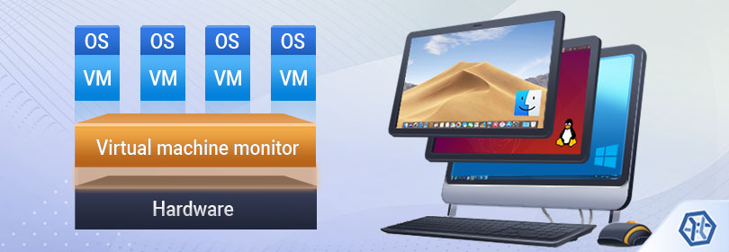
Virtual Machine
https://www.ufsexplorer.com/articles/storage-technologies/virtual-machines-data-organization.php
Notes:
A virtual machine is the virtualization/emulation of a computer system.
Virtual machines are based on computer architectures and provide functionality of a physical computer.
The virtual machine monitor is called hypervisor; it is computer software, firmware or hardware that creates and runs virtual machines.
A computer on which a hypervisor runs one or more virtual machines is called a host machine, and each virtual machine is called a guest machine.

Slide 21

Sharing is caring
More details on shared kernel resources
Software
Software
Software
Software
Docker
OS Ubuntu
Kernel
Notes:
Each container only has the additional software that is necessary to run the application inside.
It shares all system libraries with the OS kernel

Slide 22
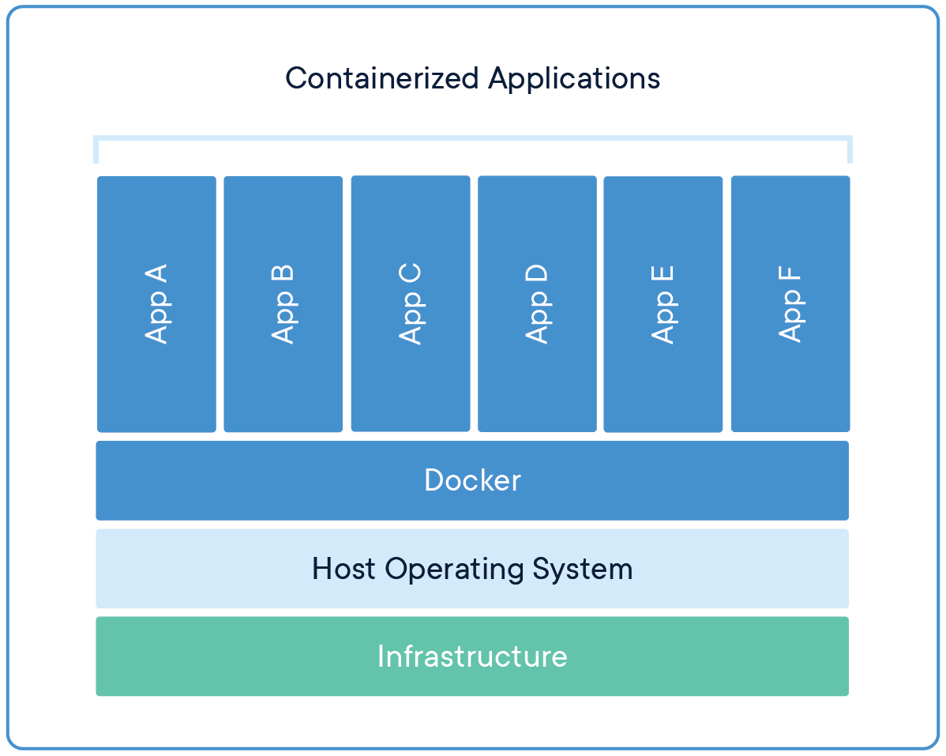
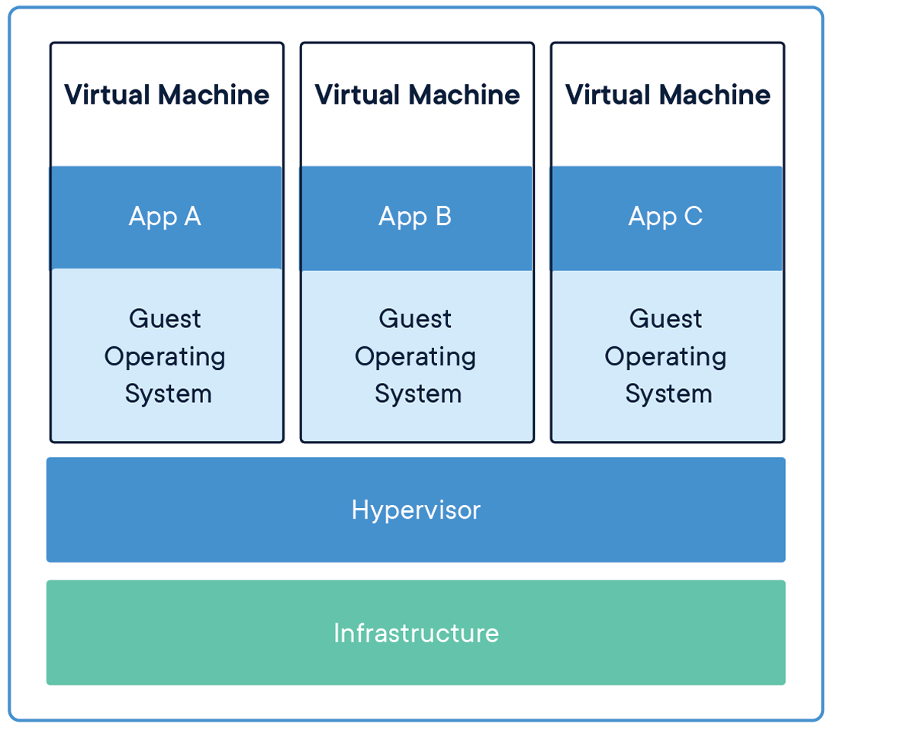
Difference Docker vs Virtual Machine
Notes:
The difference between the two becomes apparent in this overview.
Each Virtual Machine comes with a full operating system, which makes it much slower and more heavy.

Slide 23
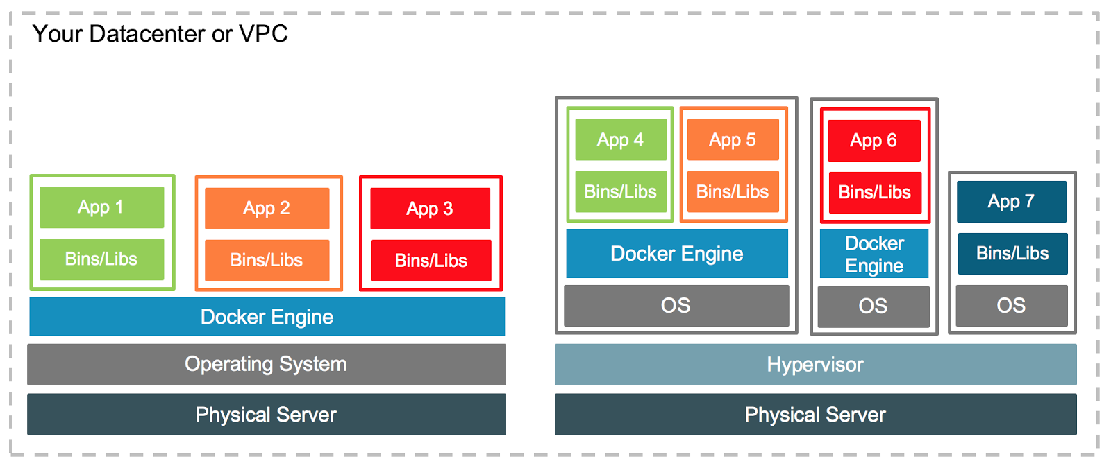
Docker and Virtual Machines
Notes:
Virtual machines and Docker are not exclusive, it is the opposite.
These days they are run together.
Computer farms have

Slide 24
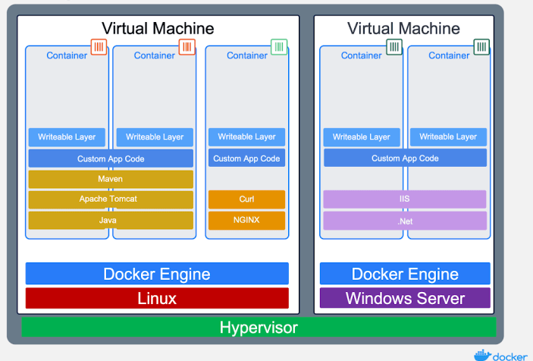
Docker and Virtual Machines

Slide 25
Cmd
Entrypoint (Genrich)
WorkingDir
Run Docker as user, not root. Or change dir
Container naming
Container ID. Mention that
Pass env vars
Versions of images
Base images
-e TERM=xterm http://www.mimastech.com/2017/01/08/how-to-setfix-the-term-environment-variable-in-docker/

Slide 26
Download an image:
docker pull [OPTIONS] NAME[:TAG|@DIGEST] #default is the latest version
docker pull ubuntu # docker pull ubuntu:latest
Create a container from an image
docker run [OPTIONS] IMAGE [COMMAND] [ARG...]
docker run -it ubuntu:latest ls –l
Run a command in a running container
docker exec [OPTIONS] CONTAINER COMMAND [ARG...]
docker exec a24faeb0b374 ls -l

Slide 27
None image
The Good <none>:<none>
These are intermediate images and can be seen using docker images -a. They don't result into a disk space problem, but they take space on the screen
The Bad <none>:<none>
These images are the dangling ones, which can cause disk space problems. These <none>:<none> images are being listed as part of docker images and need to be pruned: docker image prune
(a dangling file system layer in Docker is something that is unused and is not being referenced by any images. Hence we need a mechanism for Docker to clear these dangling images)

Slide 28
Which container are running / killing them.

Slide 29
Recap

Slide 30
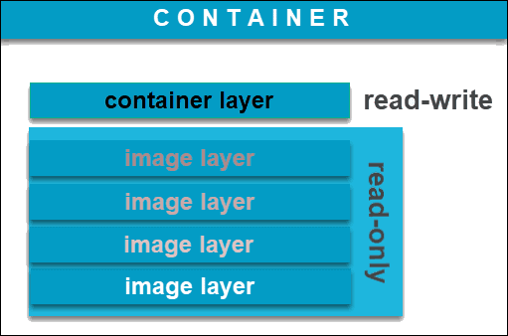
Docker image
Notes:
A Docker image is a read-only template that contains a set of instructions for creating a container that can run on the Docker platform.
Union filesystem

Slide 31
Dockerfile
Command | Purpose
FROM | To specify the parent image.
WORKDIR | To set the working directory for any commands that follow in the Dockerfile.
RUN | To install any applications and packages required for your container.
COPY | To copy over files or directories from a specific location.
ADD | As COPY, but also able to handle remote URLs and unpack compressed files.
ENTRYPOINT | Command that will always be executed when the container starts. If not specified, the default is /bin/sh -c
CMD | Arguments passed to the entrypoint. If ENTRYPOINT is not set (defaults to /bin/sh -c), the CMD will be the commands the container executes.
EXPOSE | To define which port through which to access your container application.
LABEL | To add metadata to the image.

Slide 32
Dockerfile
FROM alpine:3.13 AS builder
RUN apk update && \
apk upgrade && \
apk add git ca-certificates
RUN git clone --depth 1 https://github.com/lh3/bwa.git
RUN apk add make gcc libc-dev zlib-dev
#apk add curl libarchive-tools gcc g++ make libc-dev zlib-dev git ca-certificates
WORKDIR /bwa
RUN make
FROM alpine:3.13
COPY --from=builder /bwa/bwa /usr/local/bin
WORKDIR /mnt
ENTRYPOINT ["bwa"]
CMD []

Slide 33
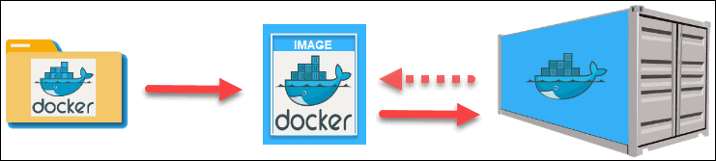
Dockerfile
https://phoenixnap.com/kb/docker-image-vs-container

Slide 34


Image sources
World’s largest repository of container images (5.5m, 13b DL/month)
Teams & Organizations
Manage access to private repositories of container images.
Official Images
Pull and use high-quality container images provided by Docker.
Publisher Images
Pull and use high- quality container images provided by external vendors.
Builds
Automatically build container images from GitHub and Bitbucket and push them to Docker Hub.
Webhooks
Trigger actions after a successful push to a repository to integrate Docker Hub with other services.
https://hub.docker.com/
Community-driven project
Specialised in bioinformatics tools
Provides the infrastructure and basic guidelines to create, manage and distribute bioinformatics packages (e.g conda) and images (e.g docker, singularity)
Provide guidelines and help on how to create reproducible pipelines and workflows using bioinformatics containers.
Users are able to request an image to be created.
https://biocontainers.pro/
https://academic.oup.com/bioinformatics/article/33/16/2580/3096437

Slide 35
Overview
Term | Description
Dockerfile | text document that contains all the commands a user could call on the command line to assemble an image.
Layer | Set of read-only files to provision the system. Think of a layer as a read only snapshot of the filesystem.
Image | Read-only layer that is the base of your container. It can have a parent image to abstract away the more basic filesystem snapshot. A Java image would inherit from a linux image with the preinstalled utilities. A tomcat image will have a Java image as the parent because it depends on Java to run Tomcat.
Container | Runnable & writeable instance of the image. Basically it is a process isolated by docker that runs on top of the filesystem that an image provides.
Registry / Hub | Central place where all publicly published images live. You can search it, upload your images there and when you pull a docker image, it comes the repository/hub.
Docker machine | VM within which you can run Docker containers. On Linux you can run docker containers natively, but on OSX and Windows you need a layer of abstraction. A docker machine will spin a very lightweight virtual machine that integrates with the docker command line utilities really well.

Slide 36

Singularity
The “Singularity Launcher” is run by the user, loads the Singularity container and executes applications as the user.
No need to virtualize everything,
No direct means to obtain root/superuser within the container
”If you want to be root inside of the container, you must first be root outside of the container”
https://sylabs.io/

Slide 37
Singularity vs Docker
Docker needs a daemon running in every node in a cluster (maintenance overhead). Singularity is only a binary which can be executed directly by any user.
Docker daemon is owned by root, sys admins need to isolate network namespace, create an accounting mechanism for resource usage, create a mechanism to let docker write in shared file systems Singularity runs as the user, using all their permissions/restrictions
Singularity is compatible with Docker
Singularity community is much smaller

Slide 38
docker –help
docker run --help

Slide 39
Exercises

Slide 40
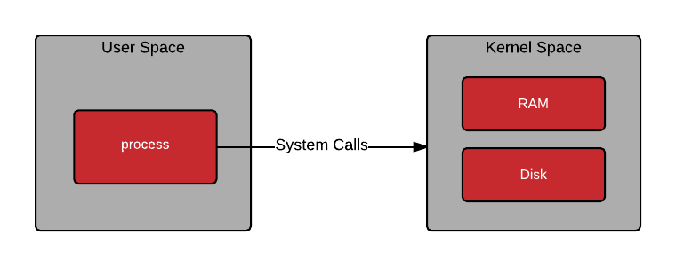
Traditional
Notes:
Kernel space has full access to all the systems resources.
User space inter

Slide 41
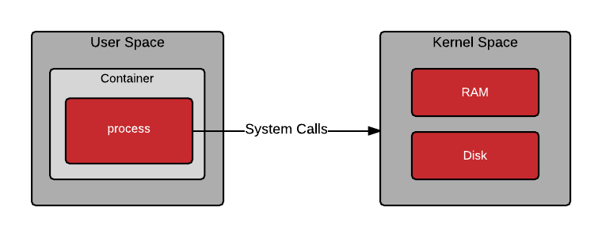
Container

Slide 42
Namespaces
Open an interactive bash shell using

Slide 43
Terminal 1
docker run -t -i --rm --privileged ubuntu:latest bash
unshare -m /bin/bash
secret_dir=`mktemp -d --tmpdir=/tmp`
echo $secret_dir
# tmp.4Jsgc4LsGh
mount -n -o size=1m -t tmpfs tmpfs $secret_dir
df –hT #shortened output
# tmpfs tmpfs 1.0M 0 1.0M 0% /tmp/tmp.hxtTL4l86R
cd $secret_dir
touch file1 file2
ls –l
Terminal 2
docker container ls –a
# CONTAINER ID IMAGE COMMAND CREATED STATUS PORTS NAMES
# e13395437ff4 ubuntu:latest "bash" 26 minutes ago Up 26 minutes distracted_
export container_id='<put CONTAINER ID here>' #in this case: export container_id='e13395437ff4'
docker exec -t -i --privileged $container_id bash
ls -l /tmp
# total 4
# drwx------ 2 root root 4096 Mar 15 04:02 tmp.4Jsgc4LsGh
cd /tmp/tmp.4Jsgc4LsGh/
ls –l
# total 8
# drwx------ 2 root root 4096 Mar 15 04:02 ./
# drwxrwxrwt 1 root root 4096 Mar 15 04:02 ../

